Slide 1
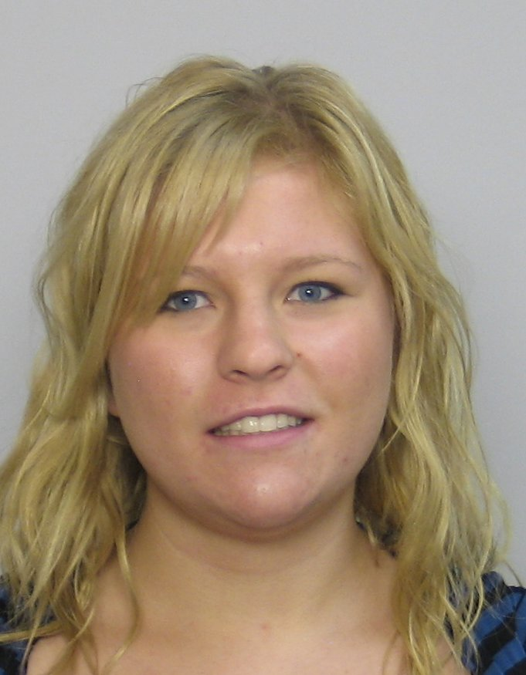
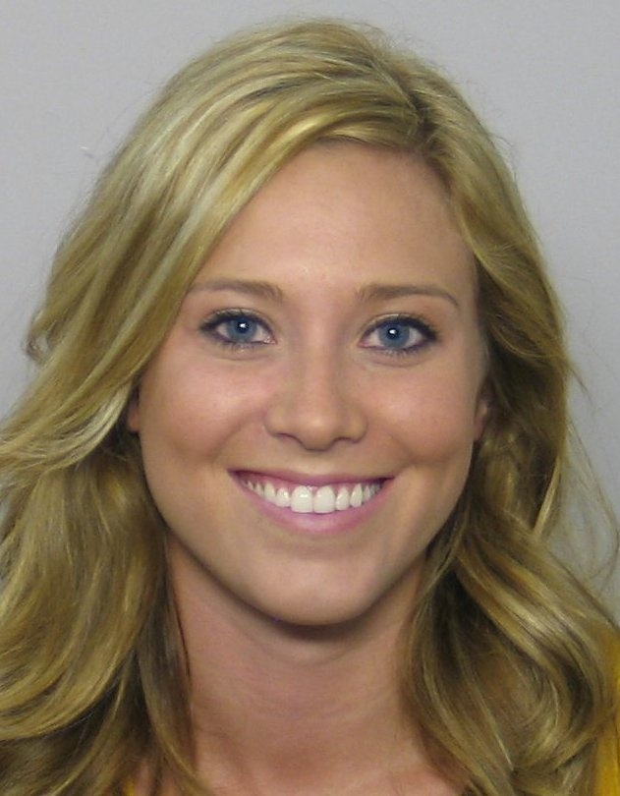
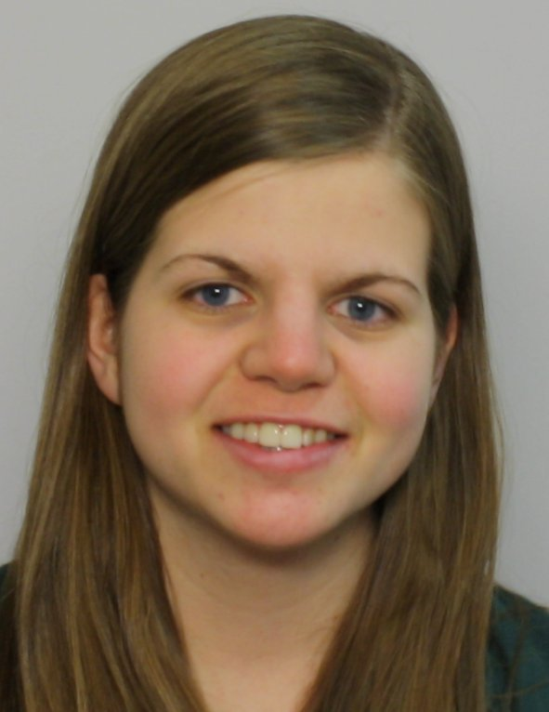
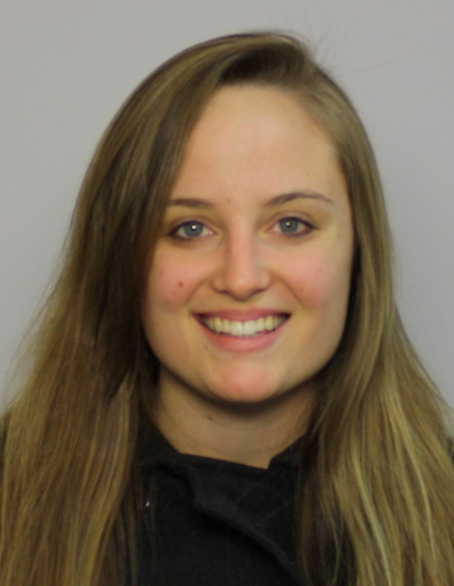
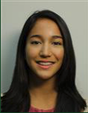
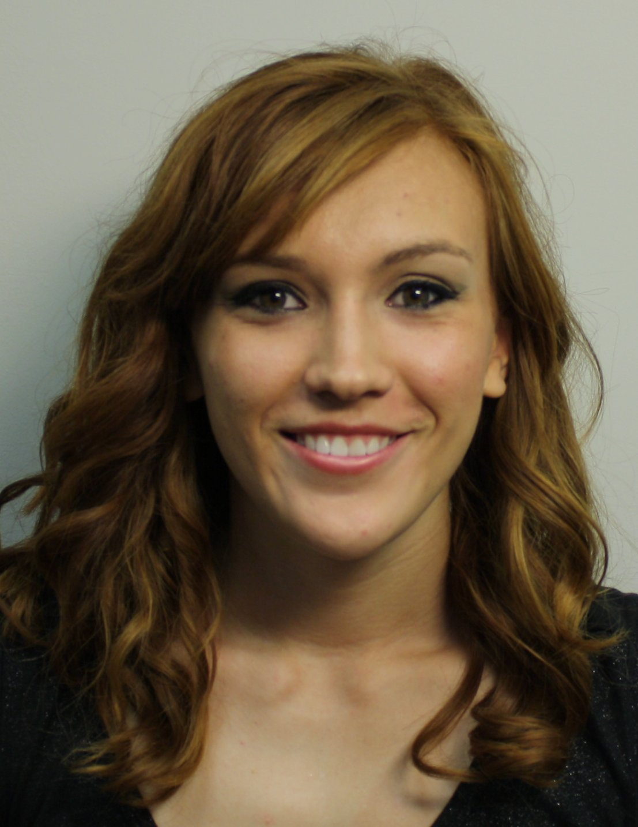
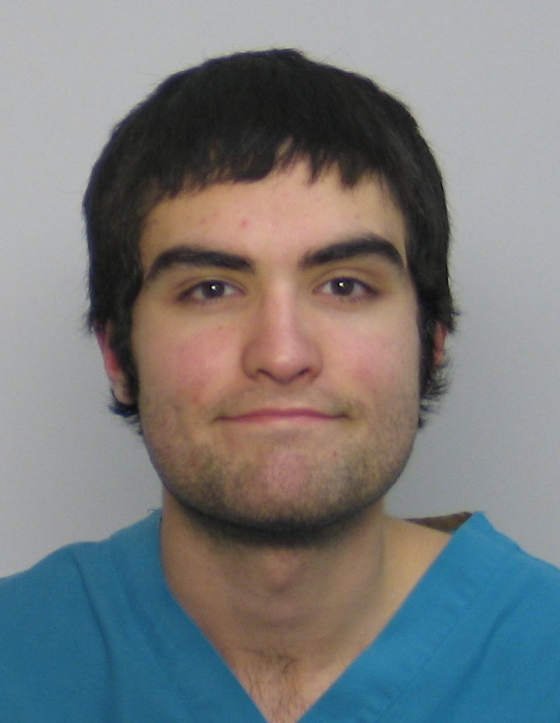
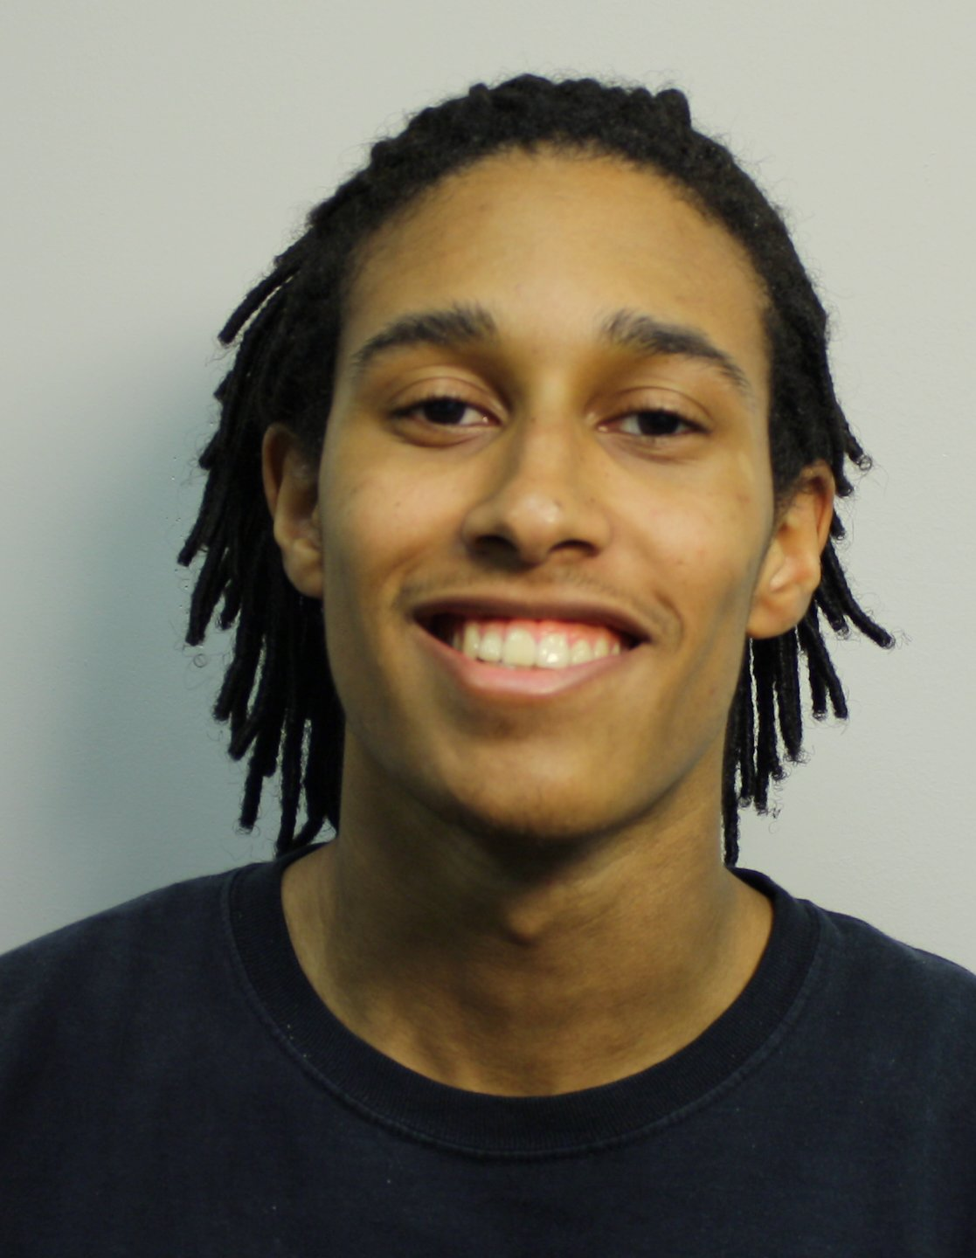
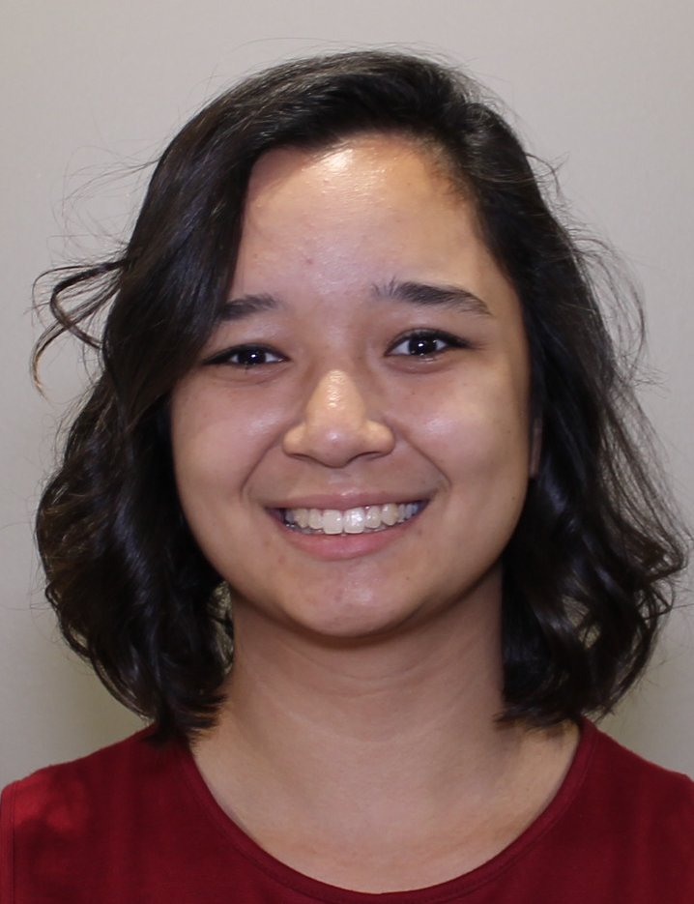
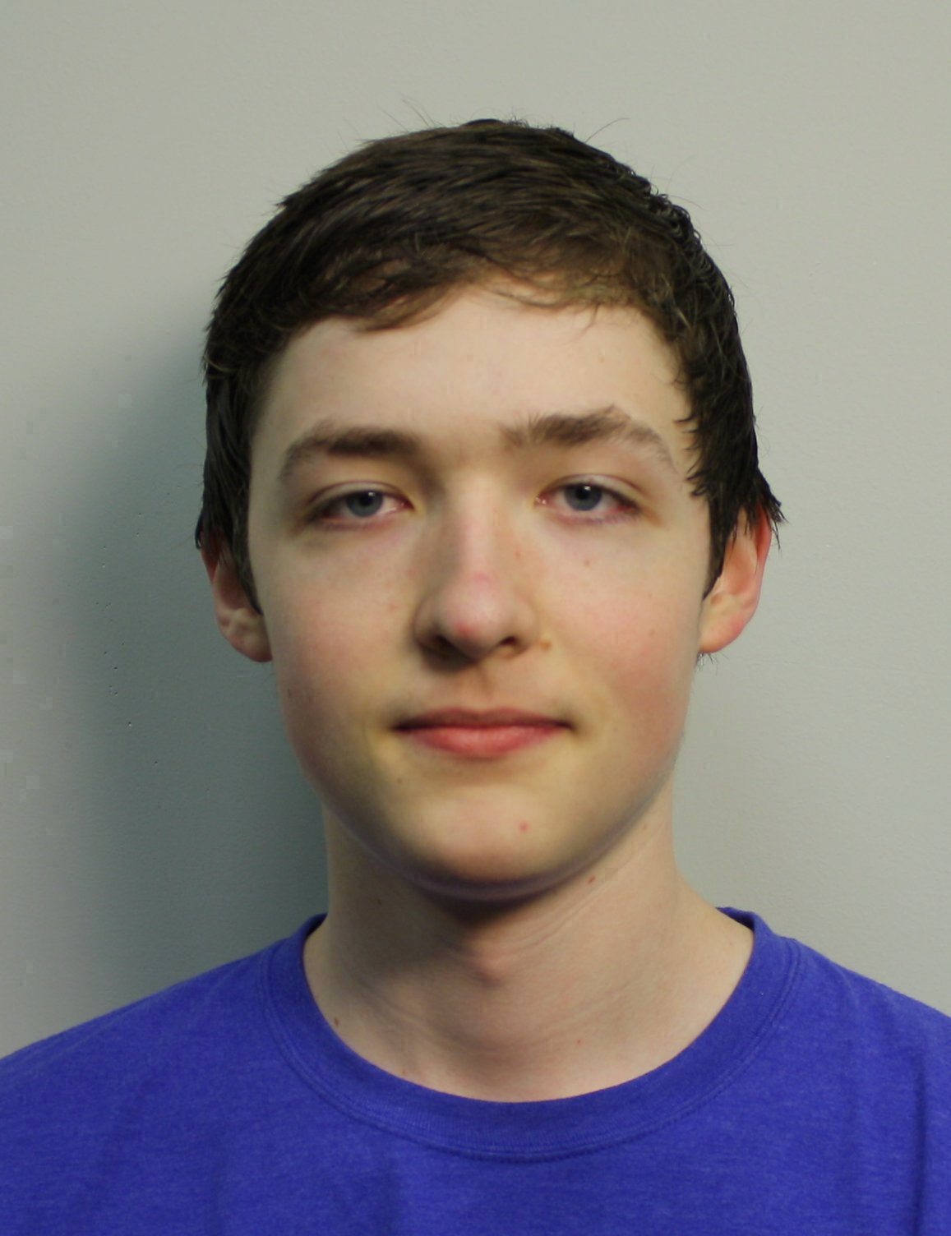
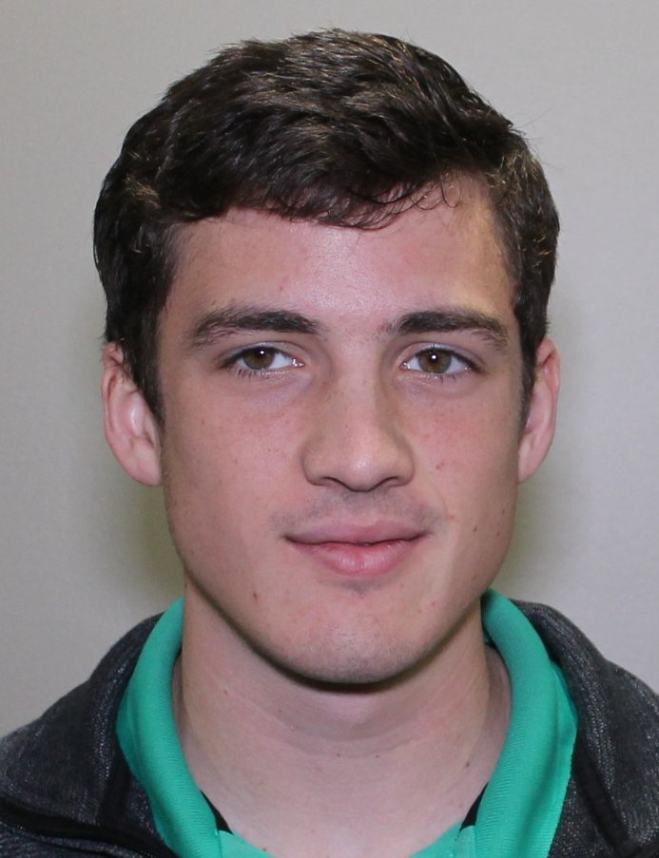
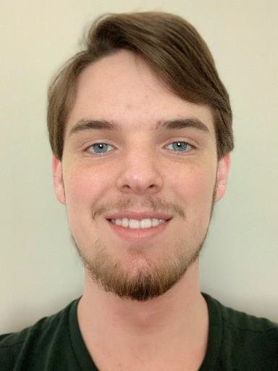
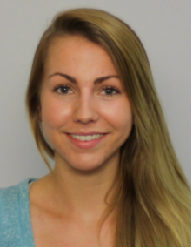
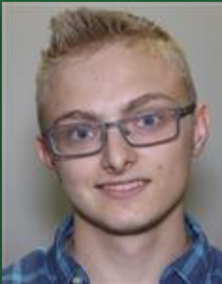
W11
Engineering
Engineering
Mathematics
Bio/Premed
Biophysics
Math/Chemistry
Breanna Bowden-Green
Kelsey Dobbs, W10
Amy Bead W12
Christen Case
F14
Jade Deschamps
S19
Camille Morrow
W18
1. Human inspection of networks.
2. Mathematical treatment of network properties.
3. Improved enumeration & acceleration.
Nursing
Biochemistry
Mathematics
Computer Sci.
CPTR Sci/Emb.Sys
Computer Sci.
Lucas Valenca, F16
Drew Blake, W17
Sarah Wu
W20
4. Logic & Planning
Josh Wade
W20
Jonathan Ziesmer, W21
Miro Manestar
Physics
Biophys/Spanish
5. Programming
Researchers in the SESSIE project Southern Adventist University
Jeanna Toulouse
W19
Christofer Trana
W19
6. Identifying Networks Mothematically

